Slide 1


Application of Machine Learning Algorithms to Predict Academic Success.
Lorena Benavides & John A Yepes – Dec 2024

Slide 2


Dataset Information
35 variables – 34 predicted variables & one is the response/Target.
Kaggle from Portugal
Each feature contains 4,424 data with no missing values.
Type:
Demographic data
Socioeconomic data.
Macroeconomic data.
Academic data at enrollment.
Academic data at the end of the first and second semesters.
The target

Slide 3
Dataset Info

Slide 4


Problem – Classification case
:
Problem: Understanding student success.
Goal: Detect students who are at risk of dropping out of their education.
Tackling student dropout rates.
Retaining students.
Target:
Dropout, Graduate, and Enrolled
Notes:
One important indicator across universities is the balance of enrollment and dropout rates, which show the failure to retain students in formal education settings and represent a major concern in post-secondary education.

Slide 5

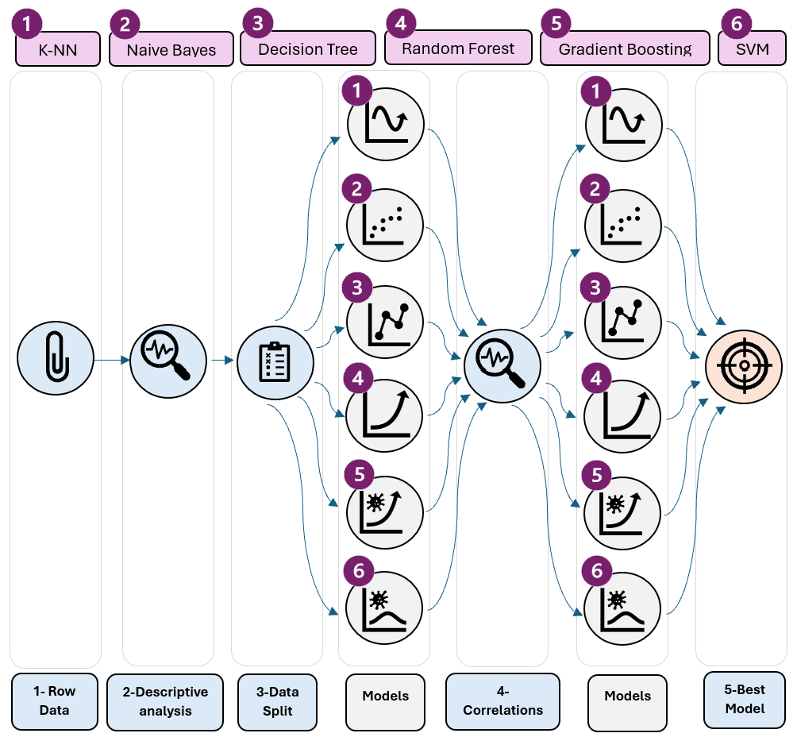
Methods & Deliverables
Visualizations (descriptive analysis)
ML algorithms
KNN
Naïve Bayes (Gaussian & Bernoulli)
Decision Tree
Random Forest
Gradient Boosting
Support Vector Machine
Results:
Accuracy (Training & test) - Graph
Confusion Matrix
Best Model
Metrix
Notes:
1. k-Nearest Neighbors, Naïve Bayes, Decision Tree, Random Forest, Gradient Boosting and SVM support vector machine were applied to predict students' academic performance. The prediction accuracy was evaluated using k-fold cross-validation. The performance of the model was measured by confusion matrix indicators. As we can't know for sure what is the best classifier that predict better we evaluate all of the and select the ones that performed better. The confusion matrix shows the current situation in the dataset and the number of correct/incorrect predictions of the model.

Slide 6

Visualizations

Slide 7
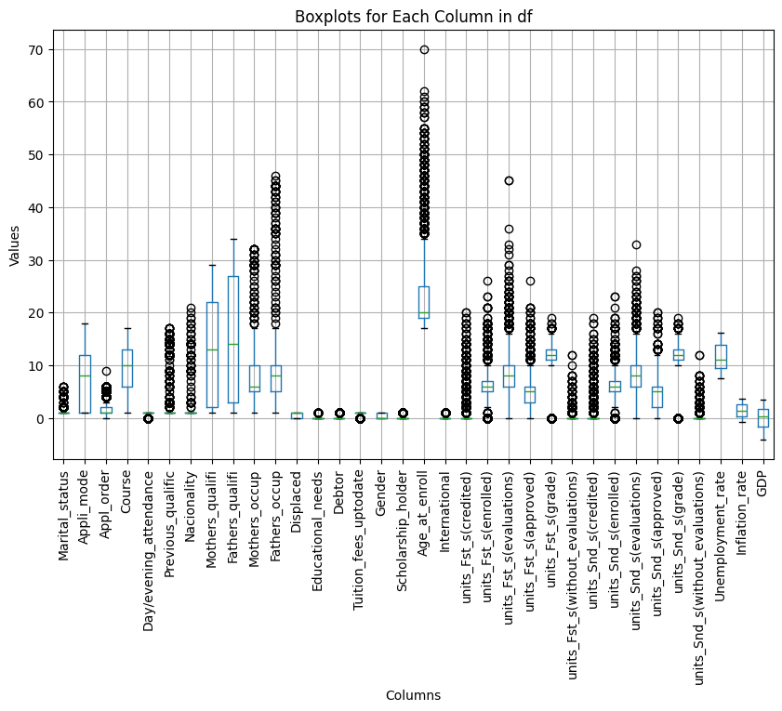

Boxplots by Target

Slide 8
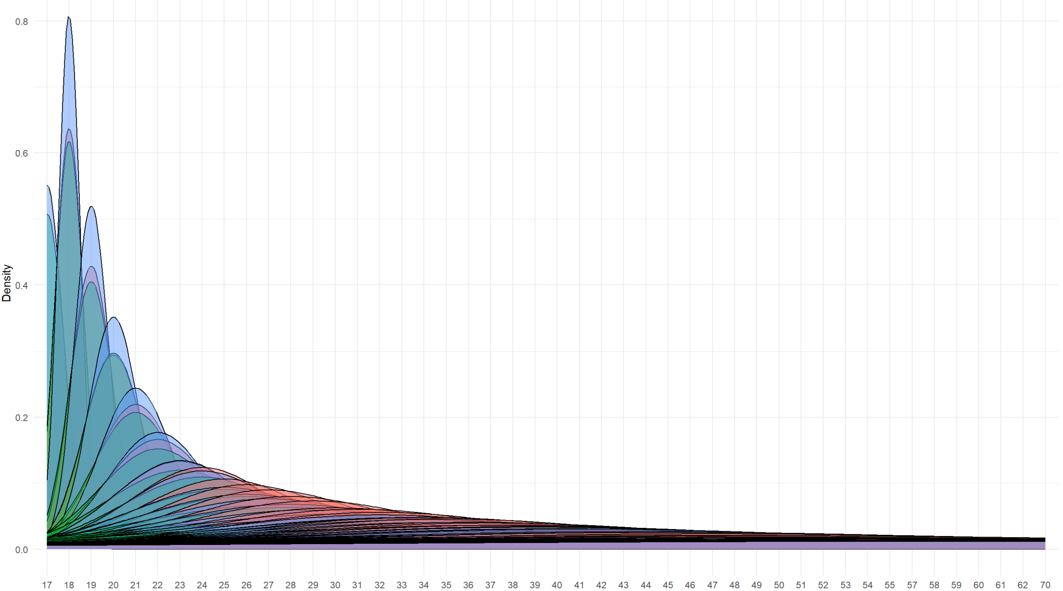

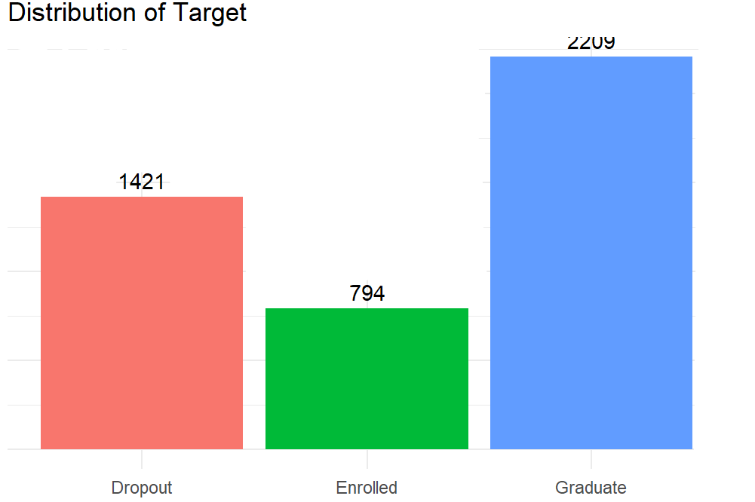
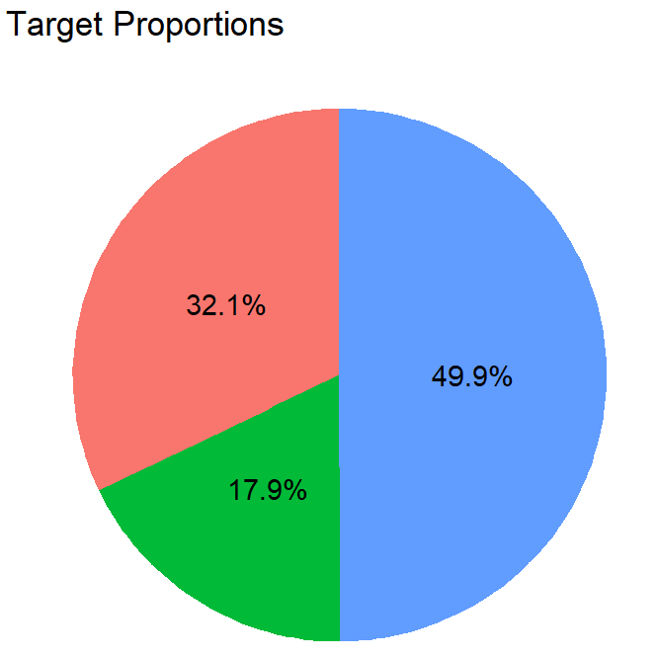
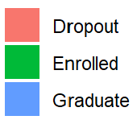
Target (4423)

Slide 9
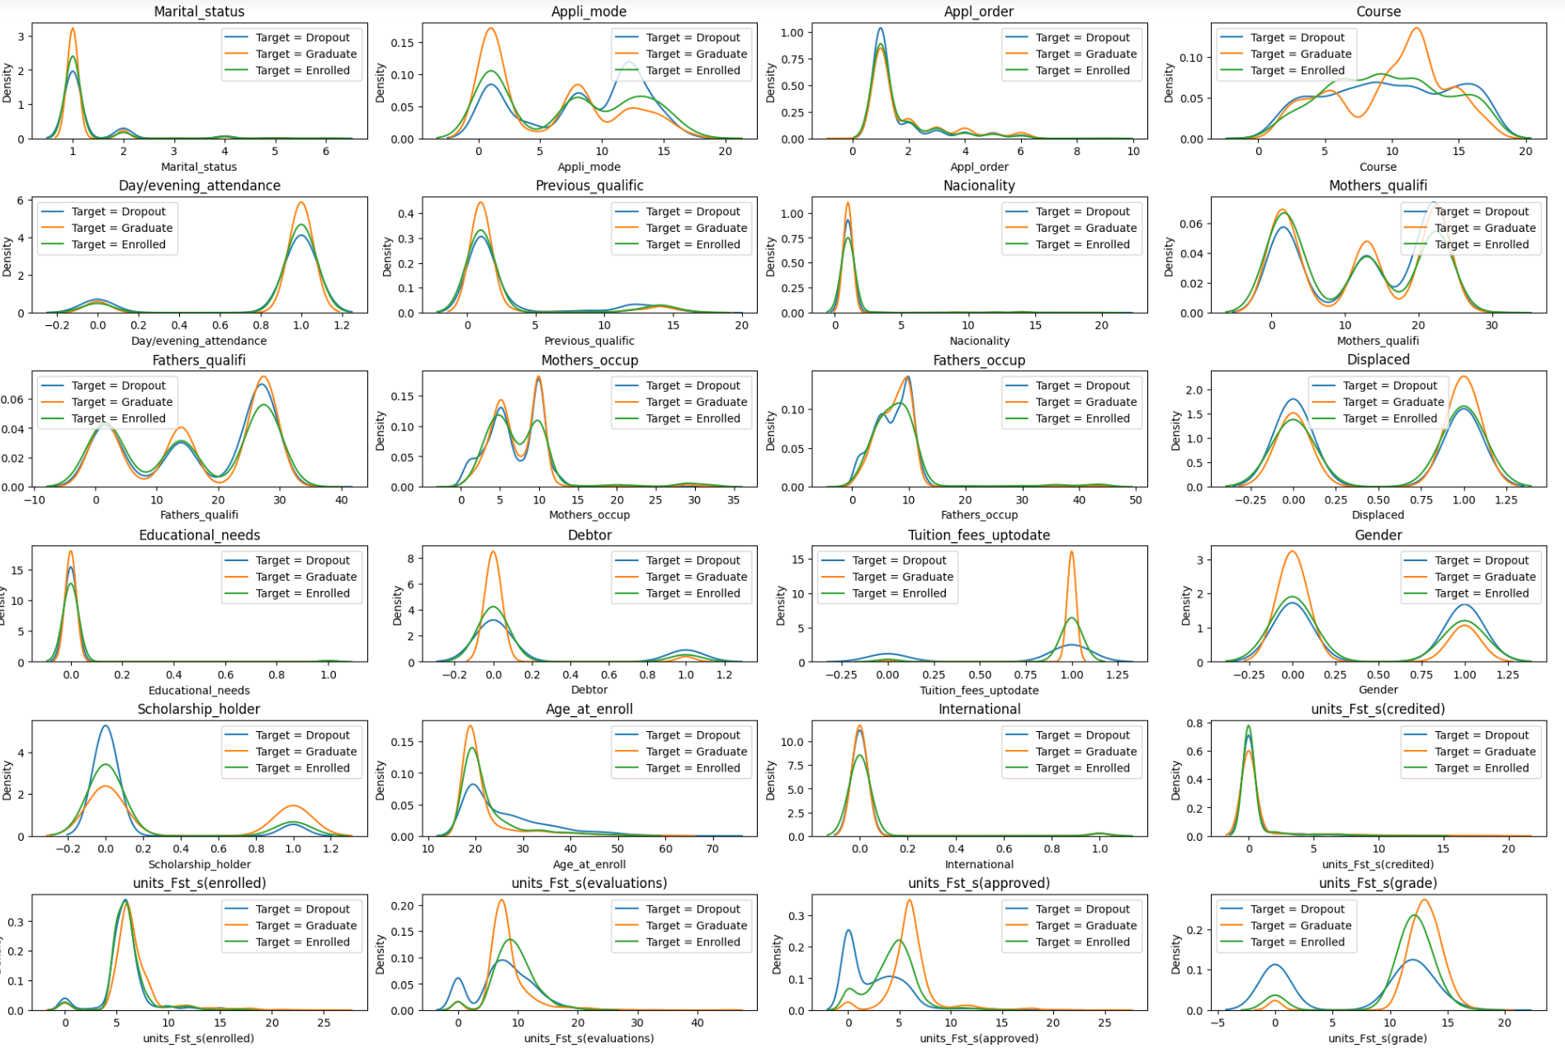
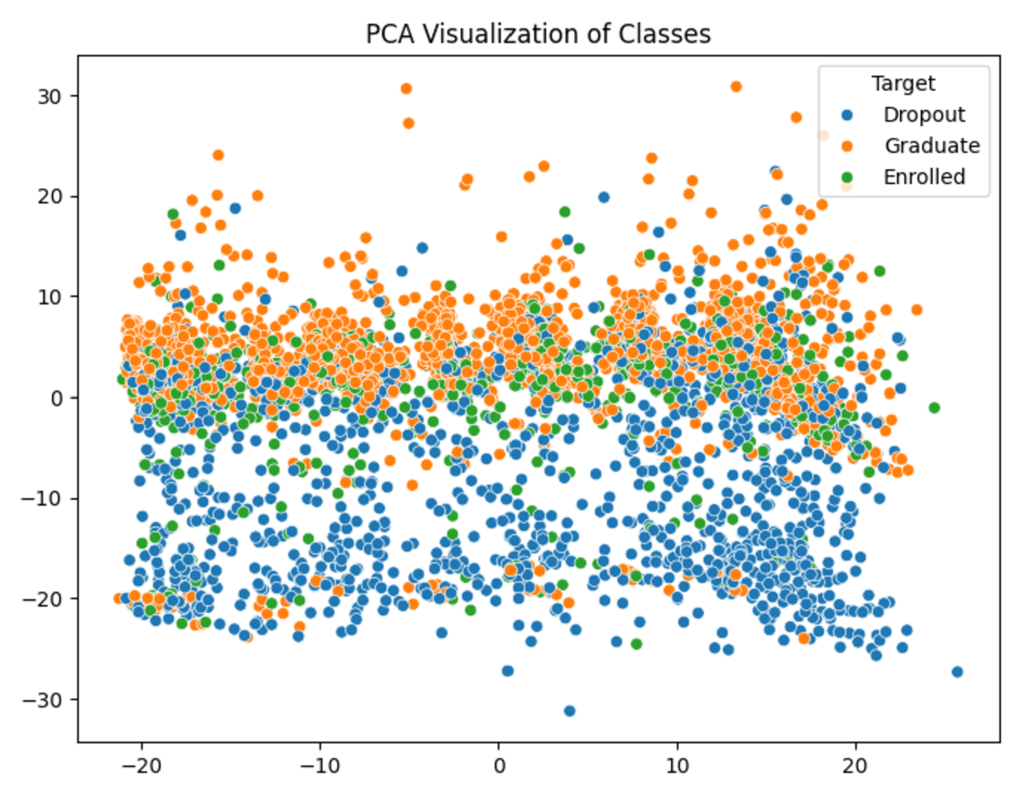
Density Plots by Target
The variable shows each target class overlap, so the classes (Dropout, Enrolled, and Graduate) are not linearly separable.

Slide 10






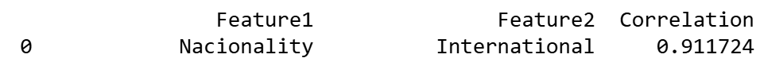
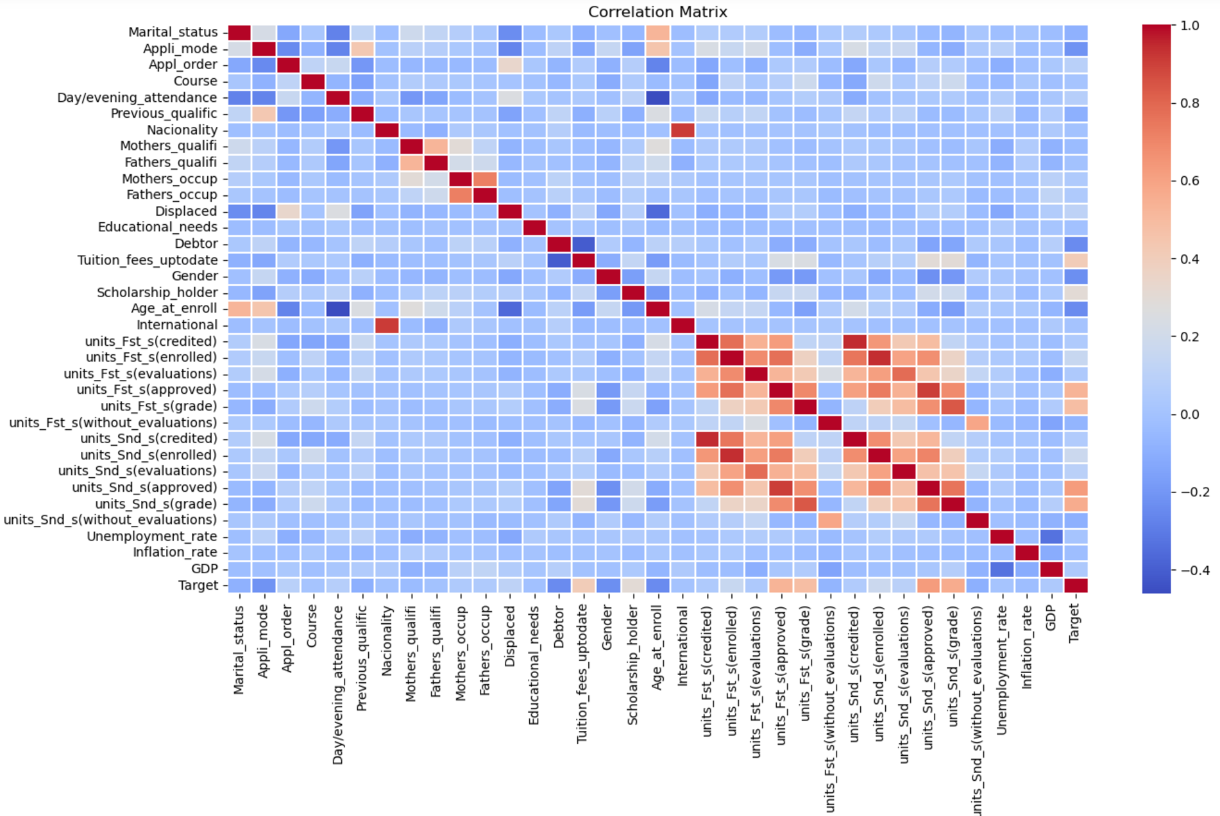


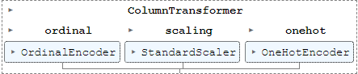
ML Process
Dataset
Split the data between Training and Testing
Transforming dataset based on data type
New Models
Filter by correlation extraction (>0.8)
Correlation > 0.8
Full data (before extraction)
Training set | 3318,33
Testing set | 1106,33
Data (After Transformation)
Training set | 3318,436
Testing set | 1106,436
Notes:
Lorena
Filter by correlation coefficient and repeated information
Scalling of the Data based on the type of data: Numerical values StandarScaler, ordinal values OrdinalEncoder, categorical values OneHotEncoder.
The performance of model was evaluated with confusion matrix, classification accuracy (CA), precision, recall, f-score (F1), and area under roc curve (AUC) metrics.

Slide 11
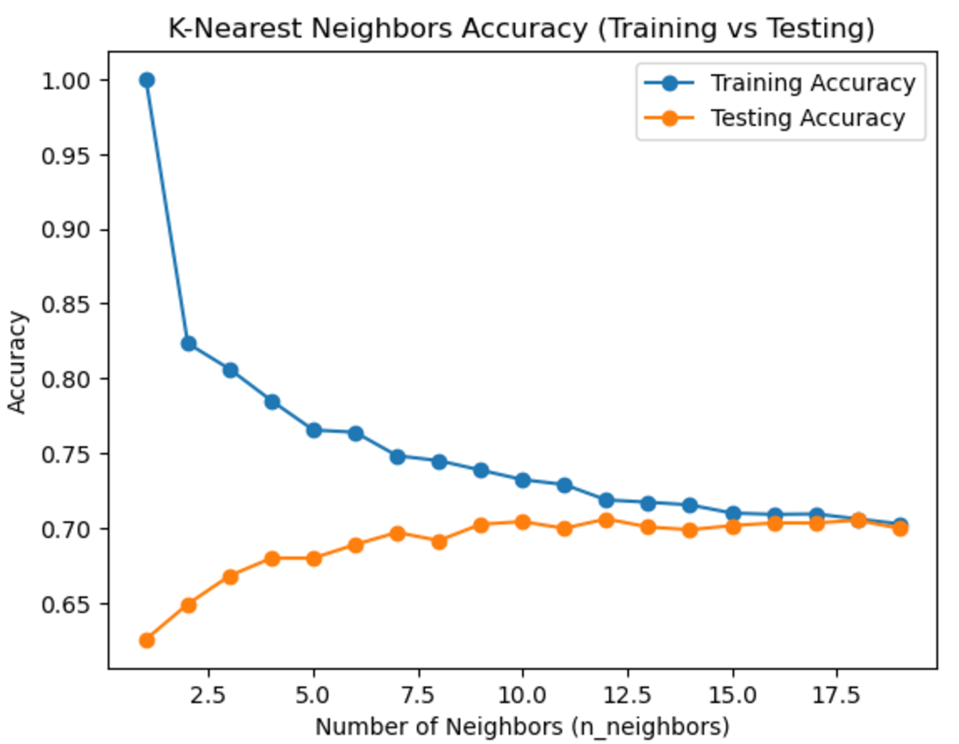
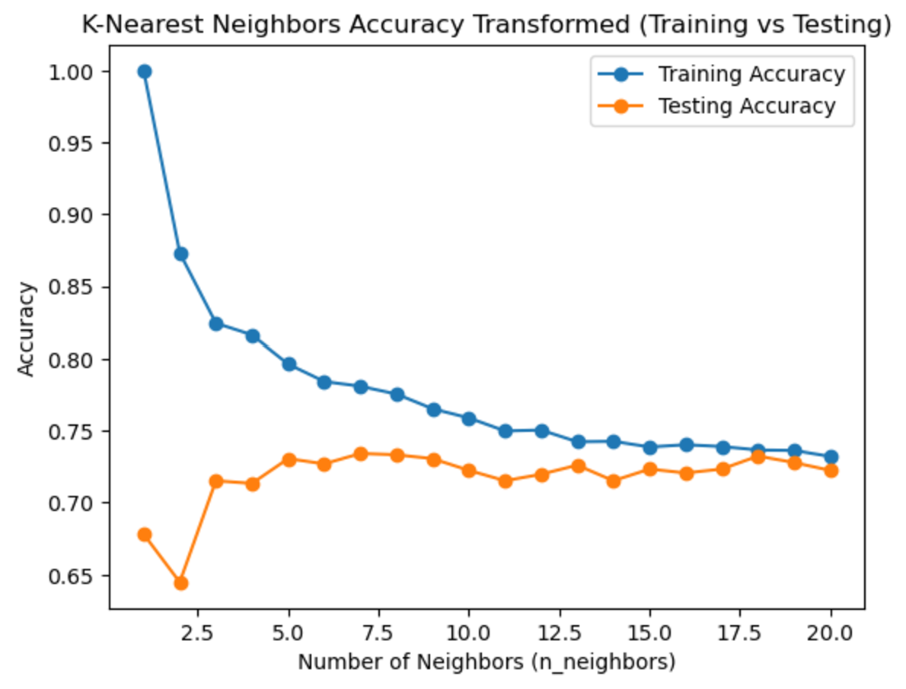
KNN
Raw Data
Transformed Data
Best test accuracy occurs at n_neighbors=18
Training set is 0.705
Testing set is 0.705
Best test accuracy occurs at n_neighbors=12
Training set is 0.750
Testing set is 0.728
Best cross-validation score: 0.699
Notes:
Classification accuracy: CA is the ratio of the correct predictions (TP + TN) to the total number of instances (TP + TN + FP + FN).

Slide 12
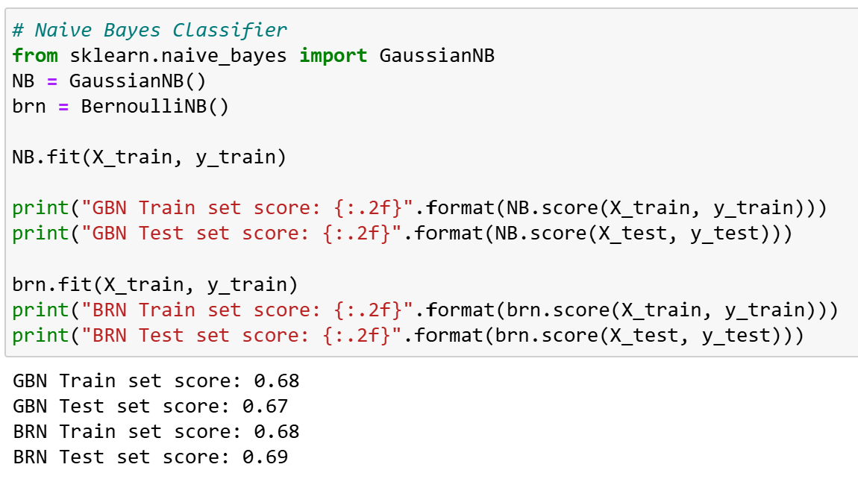
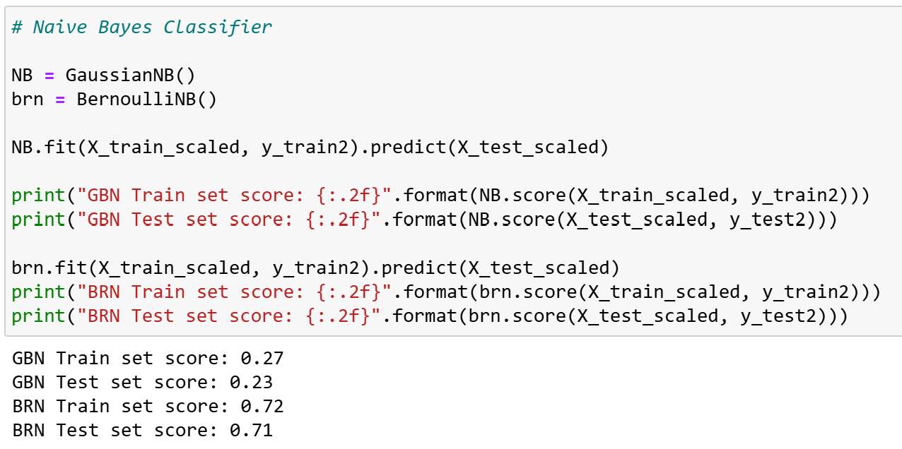
Naive Bayes (Gaussian and Bernoulli)
Raw Data
Transformed Data
Best model is Bernoulli after transforming and deleting variables.
The small gap between train and test scores indicates no overfitting or underfitting
Notes:
Lorena

Slide 13
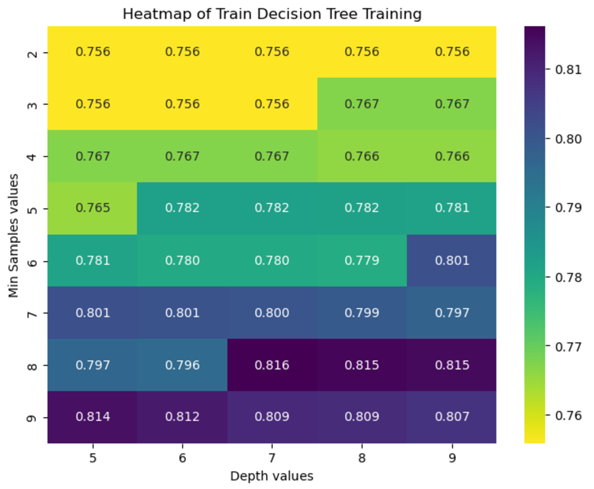
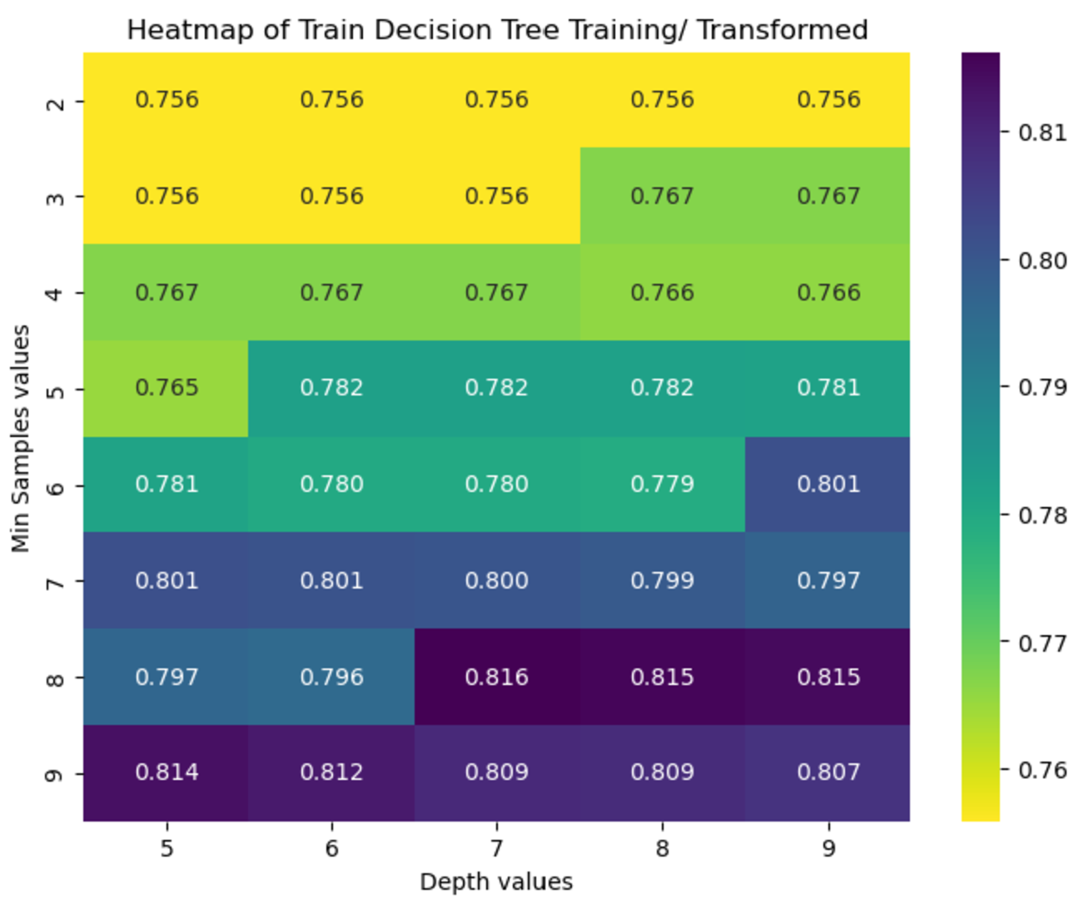
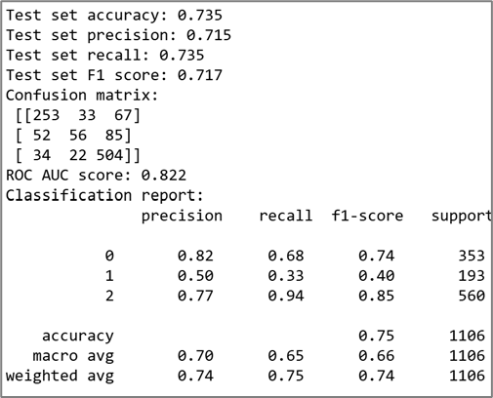
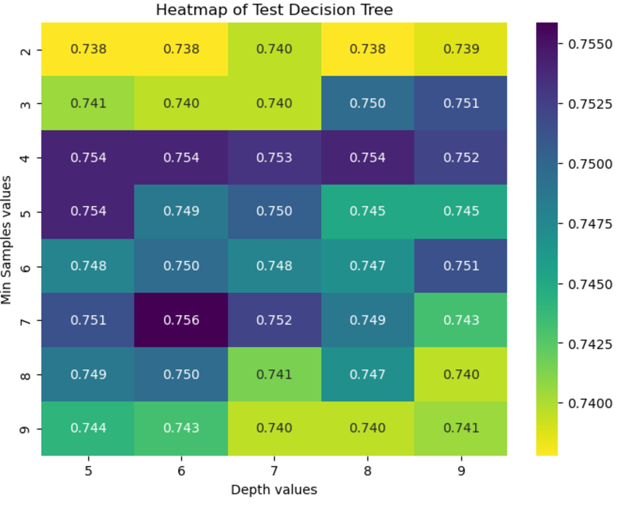
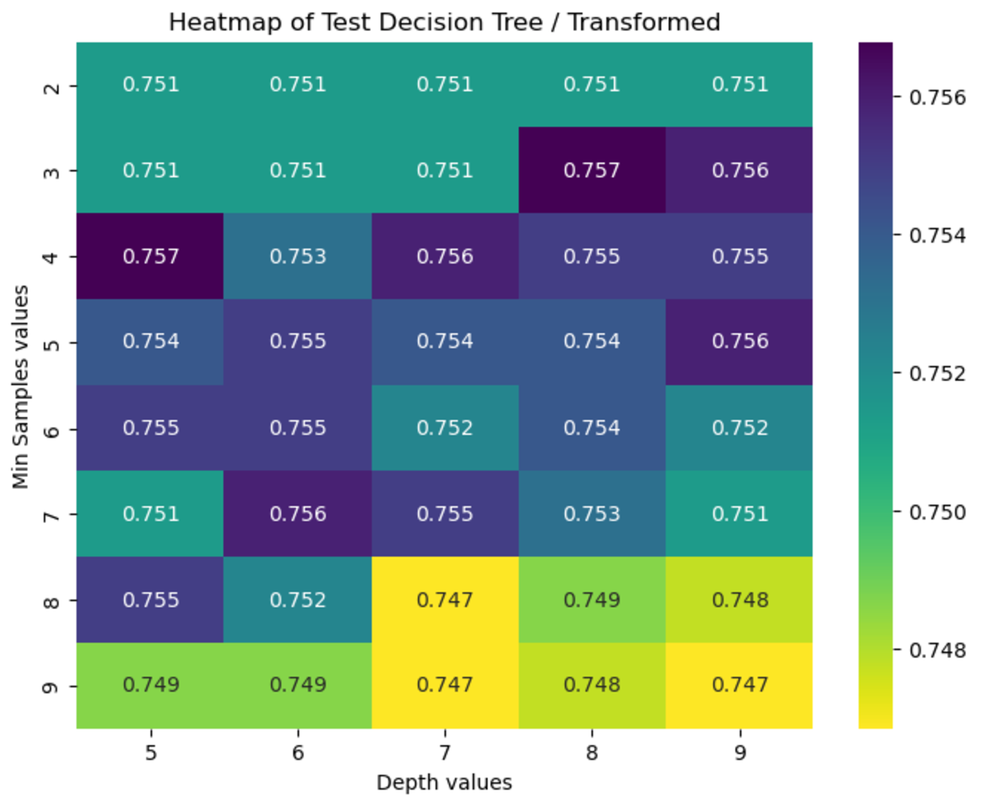
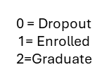
Decision Tree
Raw Data
Transformed Data
Transformed Data
Best test accuracy occurs at max_depth=5, min_samples_split=7
Training set is 0.762
Testing set is 0.741
Best test accuracy occurs at max_depth=8, min_samples_split=2 Training set 0.80
Testing set 0.7559
Notes:
In the confusion matrix of 3 ×3 dimensions, the main diagonal shows the percentage of correctly predicted instances, and the matrix elements other than the main diagonal shows the percentage of errors predicted. The model performs reasonably well overall, particularly for Graduate class. However, it struggles with Enrolled class, reflected by its low precision, recall, and F1 score. Improving the model's performance on this class could significantly enhance overall results.

Slide 14
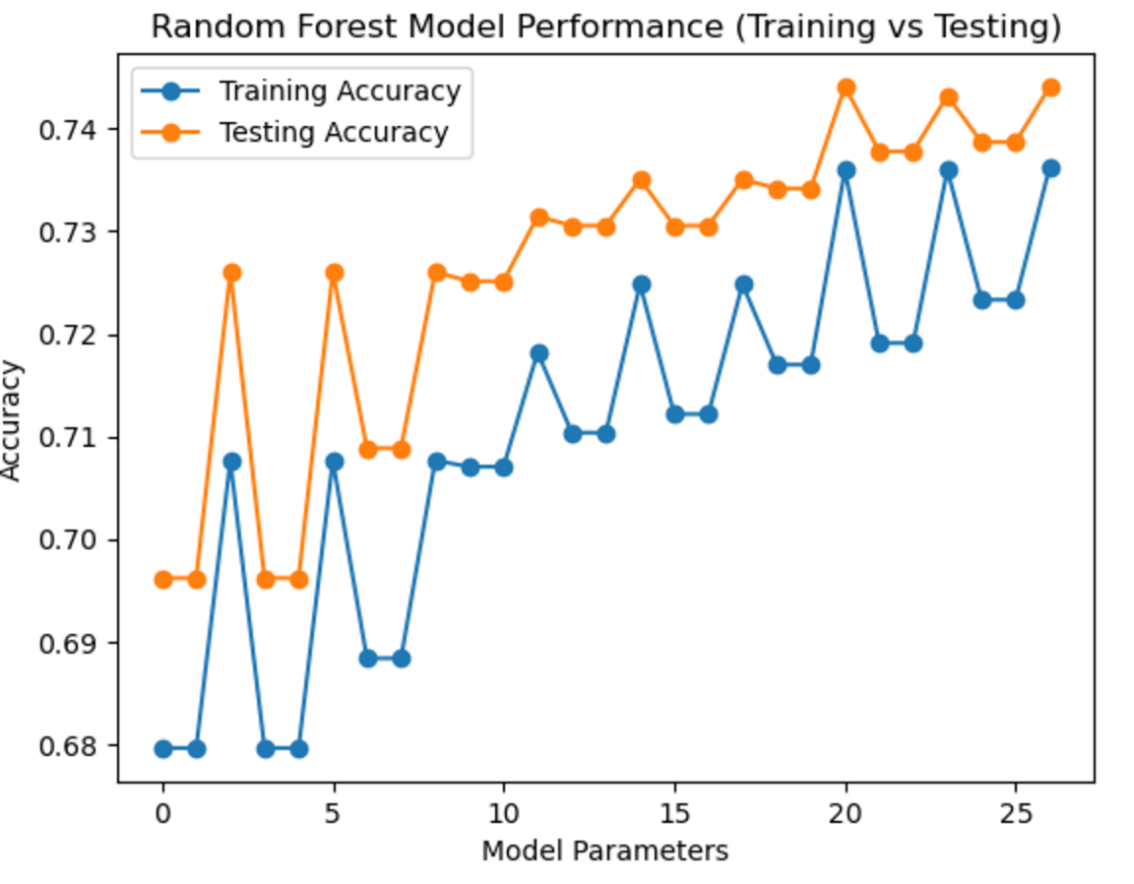
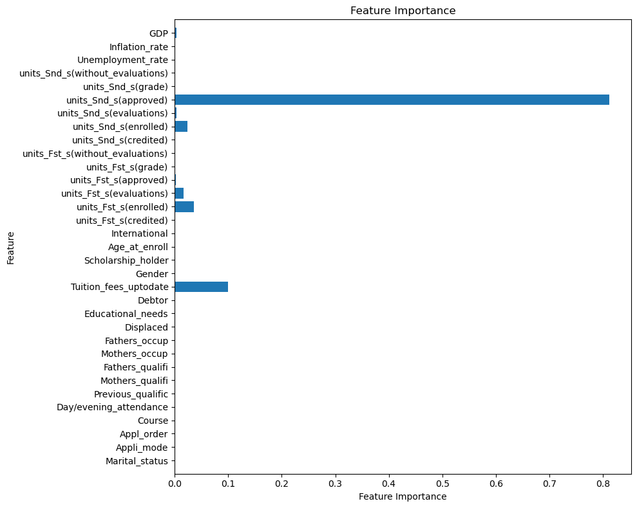
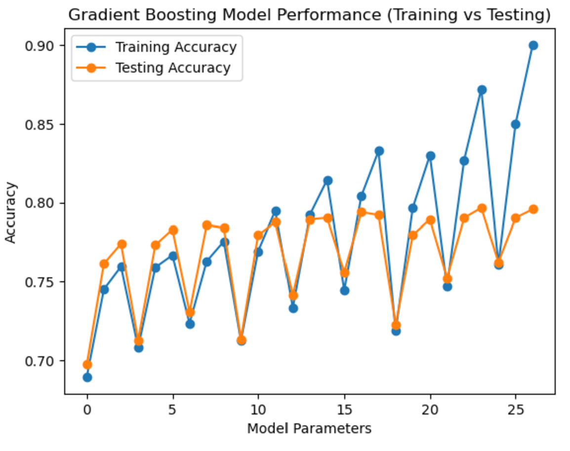
Radom Forest Model
Raw Data
Transformed Data
Testing set always is higher than training test.
No model with full data.
Best parameters found: {'max_depth': 3, 'max_features': None, 'n_estimators': 50} Best cross-validation score: 0.728 Train set is 0.74 Test set is 0.74
Notes:
Lorena

Slide 15
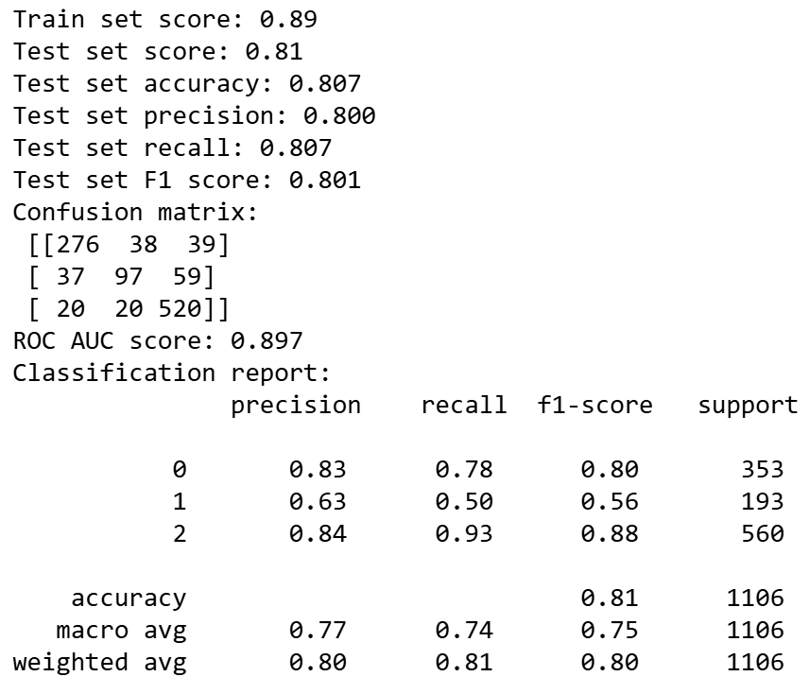
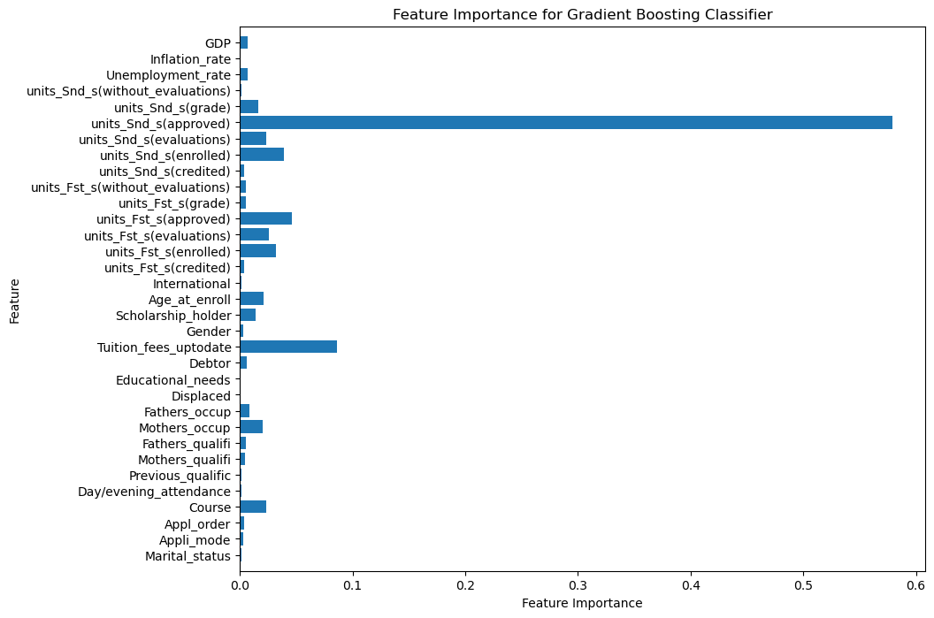
Gradient Boosting
Raw Data
Best parameters found: learning_reta=0.1, max_depth=2,n_estimatros = 100.
Train set is 0.792 Test set is 0.789
Transformed Data
Best parameters found: learning_reta=0.2, max_depth=1,n_estimatros = 150.
Best cross-validation score: 0.770 Train set is 0.833 Test set is 0.794
Notes:
The model performs well overall, with an accuracy of 80.7% and a strong ROC AUC score (0.897).
Graduate & Dropout classes are handled very well with high precision, recall, and F1 score.
Enrolled class is the weakest, with only 50% recall, indicating many true positives are missed. Improving the performance for Class 1 could further enhance the model.

Slide 16
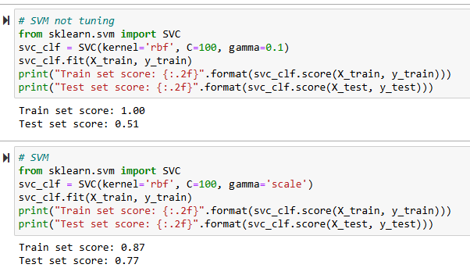
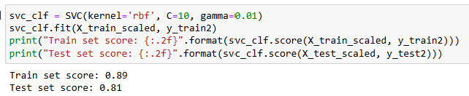
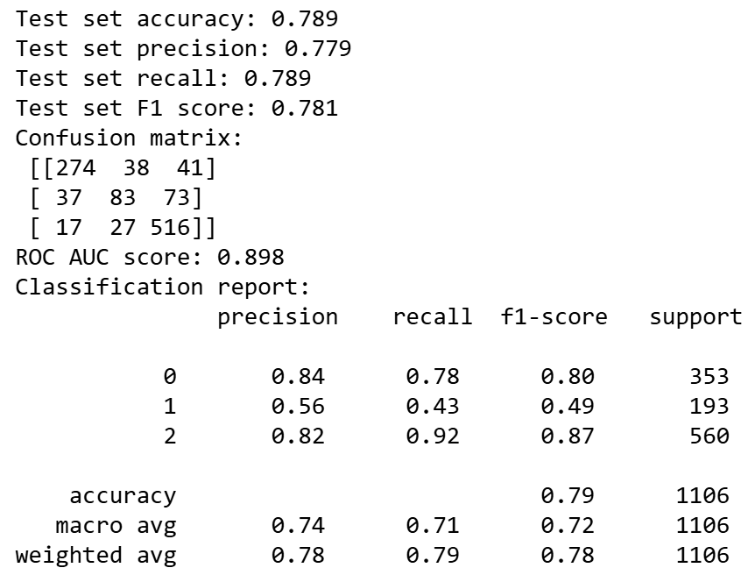
SVM
Raw Data
Transformed Data
Best parameters found: kernel=rbf, C=10 gamma=0.01, C=10
Train Accuracy = 0.89
Test Accuracy = 0.81
kernel=rbf C=100 gamma=scale
Train Accuracy = 0.87
Test Accuracy = 0.778
Notes:
Lorena

Slide 17
Conclusions
The models encounter an underfitting problem. Therefore, to obtain optimum performance 33 features were selected.
Even thought for some models it is not required to scale the data, we found some improvement in general for all models.
Gradient Boosting and SVM models algorithms perform with more accurate results in predicting dropouts of students with machine learning algorithms, while Naive Bayes has the lowest classification accuracy.
The proposed model predicted the risk of dropout of students with 79% accuracy in average. Therefore, dropout risk can be predicted with this model in the future.

Slide 18

References
[1] “P_R_Dashboard_2022Cohort,” Tableau Software. Accessed: Oct. 25, 2024. [Online]. Available: https://public.tableau.com/views/P_R_Dashboard_2022Cohort/PR_Dashboard?:embed=y&:showVizHome=no&:host_url=https%3A%2F%2Fpublic.tableau.com%2F&:embed_code_version=3&:tabs=no&:toolbar=yes&:animate_transition=yes&:display_static_image=no&:display_spinner=no&:display_overlay=yes&:display_count=yes&:language=en-US&:loadOrderID=0
[2] A. W. Astin, Assessment for excellence: The philosophy and practice of assessment and evaluation in higher education. Rowman & Littlefield Publishers, 2012.
[3] C. Gibson, S. Rankin, and T. York, “Defining and measuring academic success,” Pract. Assess. Res. Eval., vol. 20, no. 5, p. 20, 2015.
[4] R. Los and A. Schweinle, “The interaction between student motivation and the instructional environment on academic outcome: a hierarchical linear model,” Soc. Psychol. Educ., vol. 22, no. 2, pp. 471–500, Apr. 2019, doi: 10.1007/s11218-019-09487-5.
[5] A. I. Adekitan and E. Noma-Osaghae, “Data mining approach to predicting the performance of first year student in a university using the admission requirements,” Educ. Inf. Technol., vol. 24, pp. 1527–1543, 2019.
[6] O. Zawacki-Richter, V. I. Marín, M. Bond, and F. Gouverneur, “Systematic review of research on artificial intelligence applications in higher education–where are the educators?,” Int. J. Educ. Technol. High. Educ., vol. 16, no. 1, pp. 1–27, 2019.

Slide 19
References
[7] S. Hussain and M. Q. Khan, “Student-Performulator: Predicting Students’ Academic Performance at Secondary and Intermediate Level Using Machine Learning,” Ann. Data Sci., vol. 10, no. 3, pp. 637–655, Jun. 2023, doi: 10.1007/s40745-021-00341-0.
[8] M. Yağcı, “Educational data mining: prediction of students’ academic performance using machine learning algorithms,” Smart Learn. Environ., vol. 9, no. 1, p. 11, Mar. 2022, doi: 10.1186/s40561-022-00192-z.
[9] L. R. Pelima, Y. Sukmana, and Y. Rosmansyah, “Predicting University Student Graduation Using Academic Performance and Machine Learning: A Systematic Literature Review,” IEEE Access, vol. 12, pp. 23451–23465, 2024, doi: 10.1109/ACCESS.2024.3361479.
[10] A. Singh, M. N., and R. Lakshmiganthan, “Impact of Different Data Types on Classifier Performance of Random Forest, Naïve Bayes, and K-Nearest Neighbors Algorithms,” Int. J. Adv. Comput. Sci. Appl., vol. 8, no. 12, 2017, doi: 10.14569/IJACSA.2017.081201.
[11] N. Salmi and Z. Rustam, “Naïve Bayes classifier models for predicting the colon cancer,” in IOP conference series: materials science and engineering, IOP Publishing, 2019, p. 052068.
[12] Y. Lu, T. Ye, and J. Zheng, “Decision Tree Algorithm in Machine Learning,” in 2022 IEEE International Conference on Advances in Electrical Engineering and Computer Applications (AEECA), Aug. 2022, pp. 1014–1017. doi: 10.1109/AEECA55500.2022.9918857.

Slide 20
References
[13] P. Probst and A.-L. Boulesteix, “To Tune or Not to Tune the Number of Trees in Random Forest”.
[14] Z. Tian, J. Xiao, H. Feng, and Y. Wei, “Credit Risk Assessment based on Gradient Boosting Decision Tree,” Procedia Comput. Sci., vol. 174, pp. 150–160, Jan. 2020, doi: 10.1016/j.procs.2020.06.070.
[15] D. Isa, L. H. Lee, V. P. Kallimani, and R. RajKumar, “Text Document Preprocessing with the Bayes Formula for Classification Using the Support Vector Machine,” IEEE Trans. Knowl. Data Eng., vol. 20, no. 9, pp. 1264–1272, Sep. 2008, doi: 10.1109/TKDE.2008.76.
[16] “Find Open Datasets and Machine Learning Projects | Kaggle.” Accessed: Oct. 25, 2024. [Online]. Available: https://www.kaggle.com/datasets

Slide 21


